Slide 1
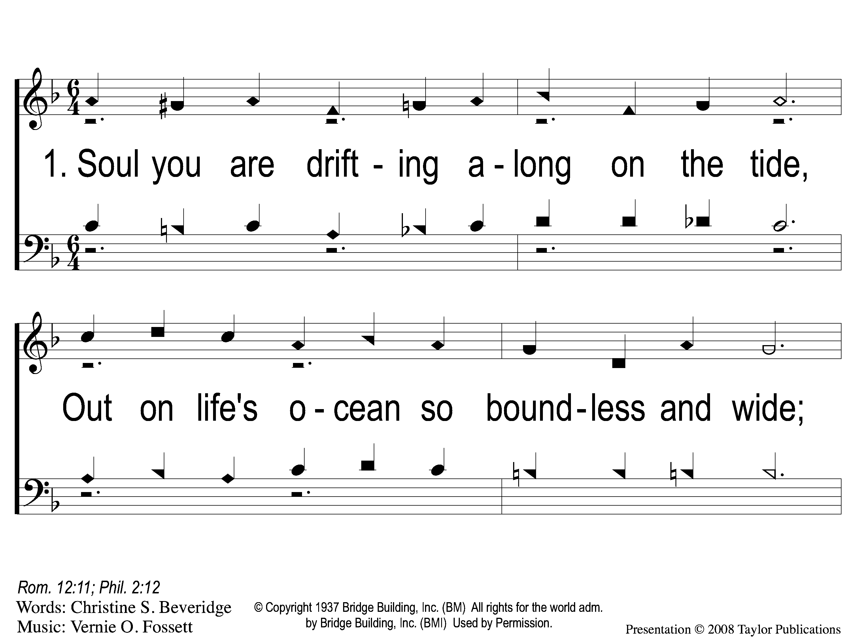
1-1 Drifting Alone
Drifting Along
91

Slide 2
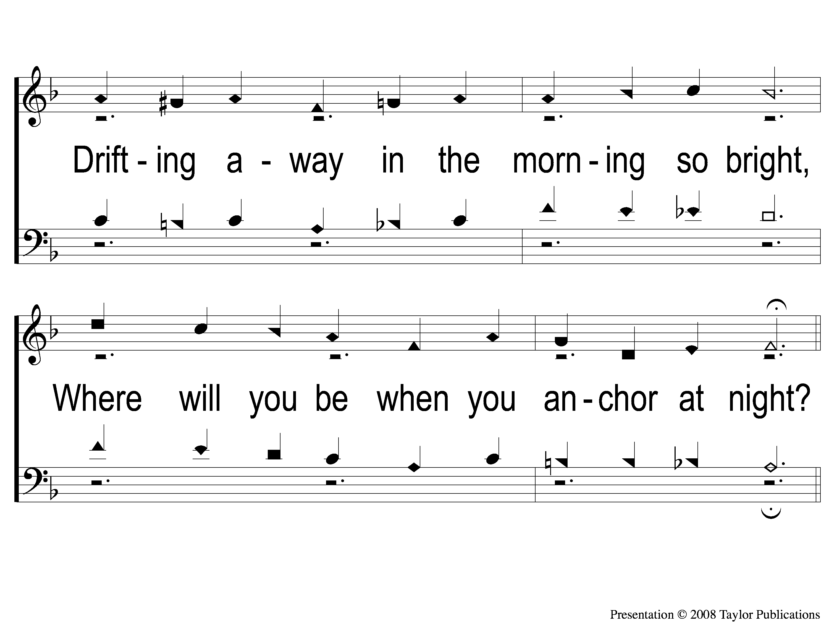
1-2 Drifting Alone
Drifting Along
91

Slide 3
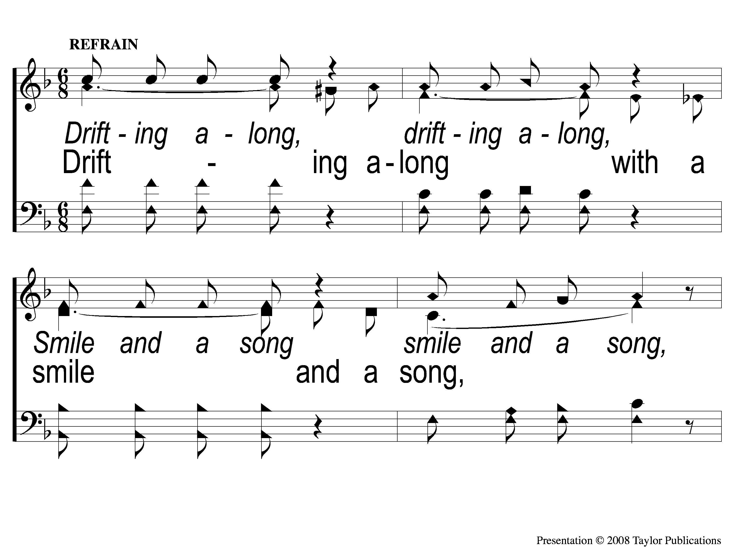
C-1 Drifting Alone
Drifting Along
91

Slide 4
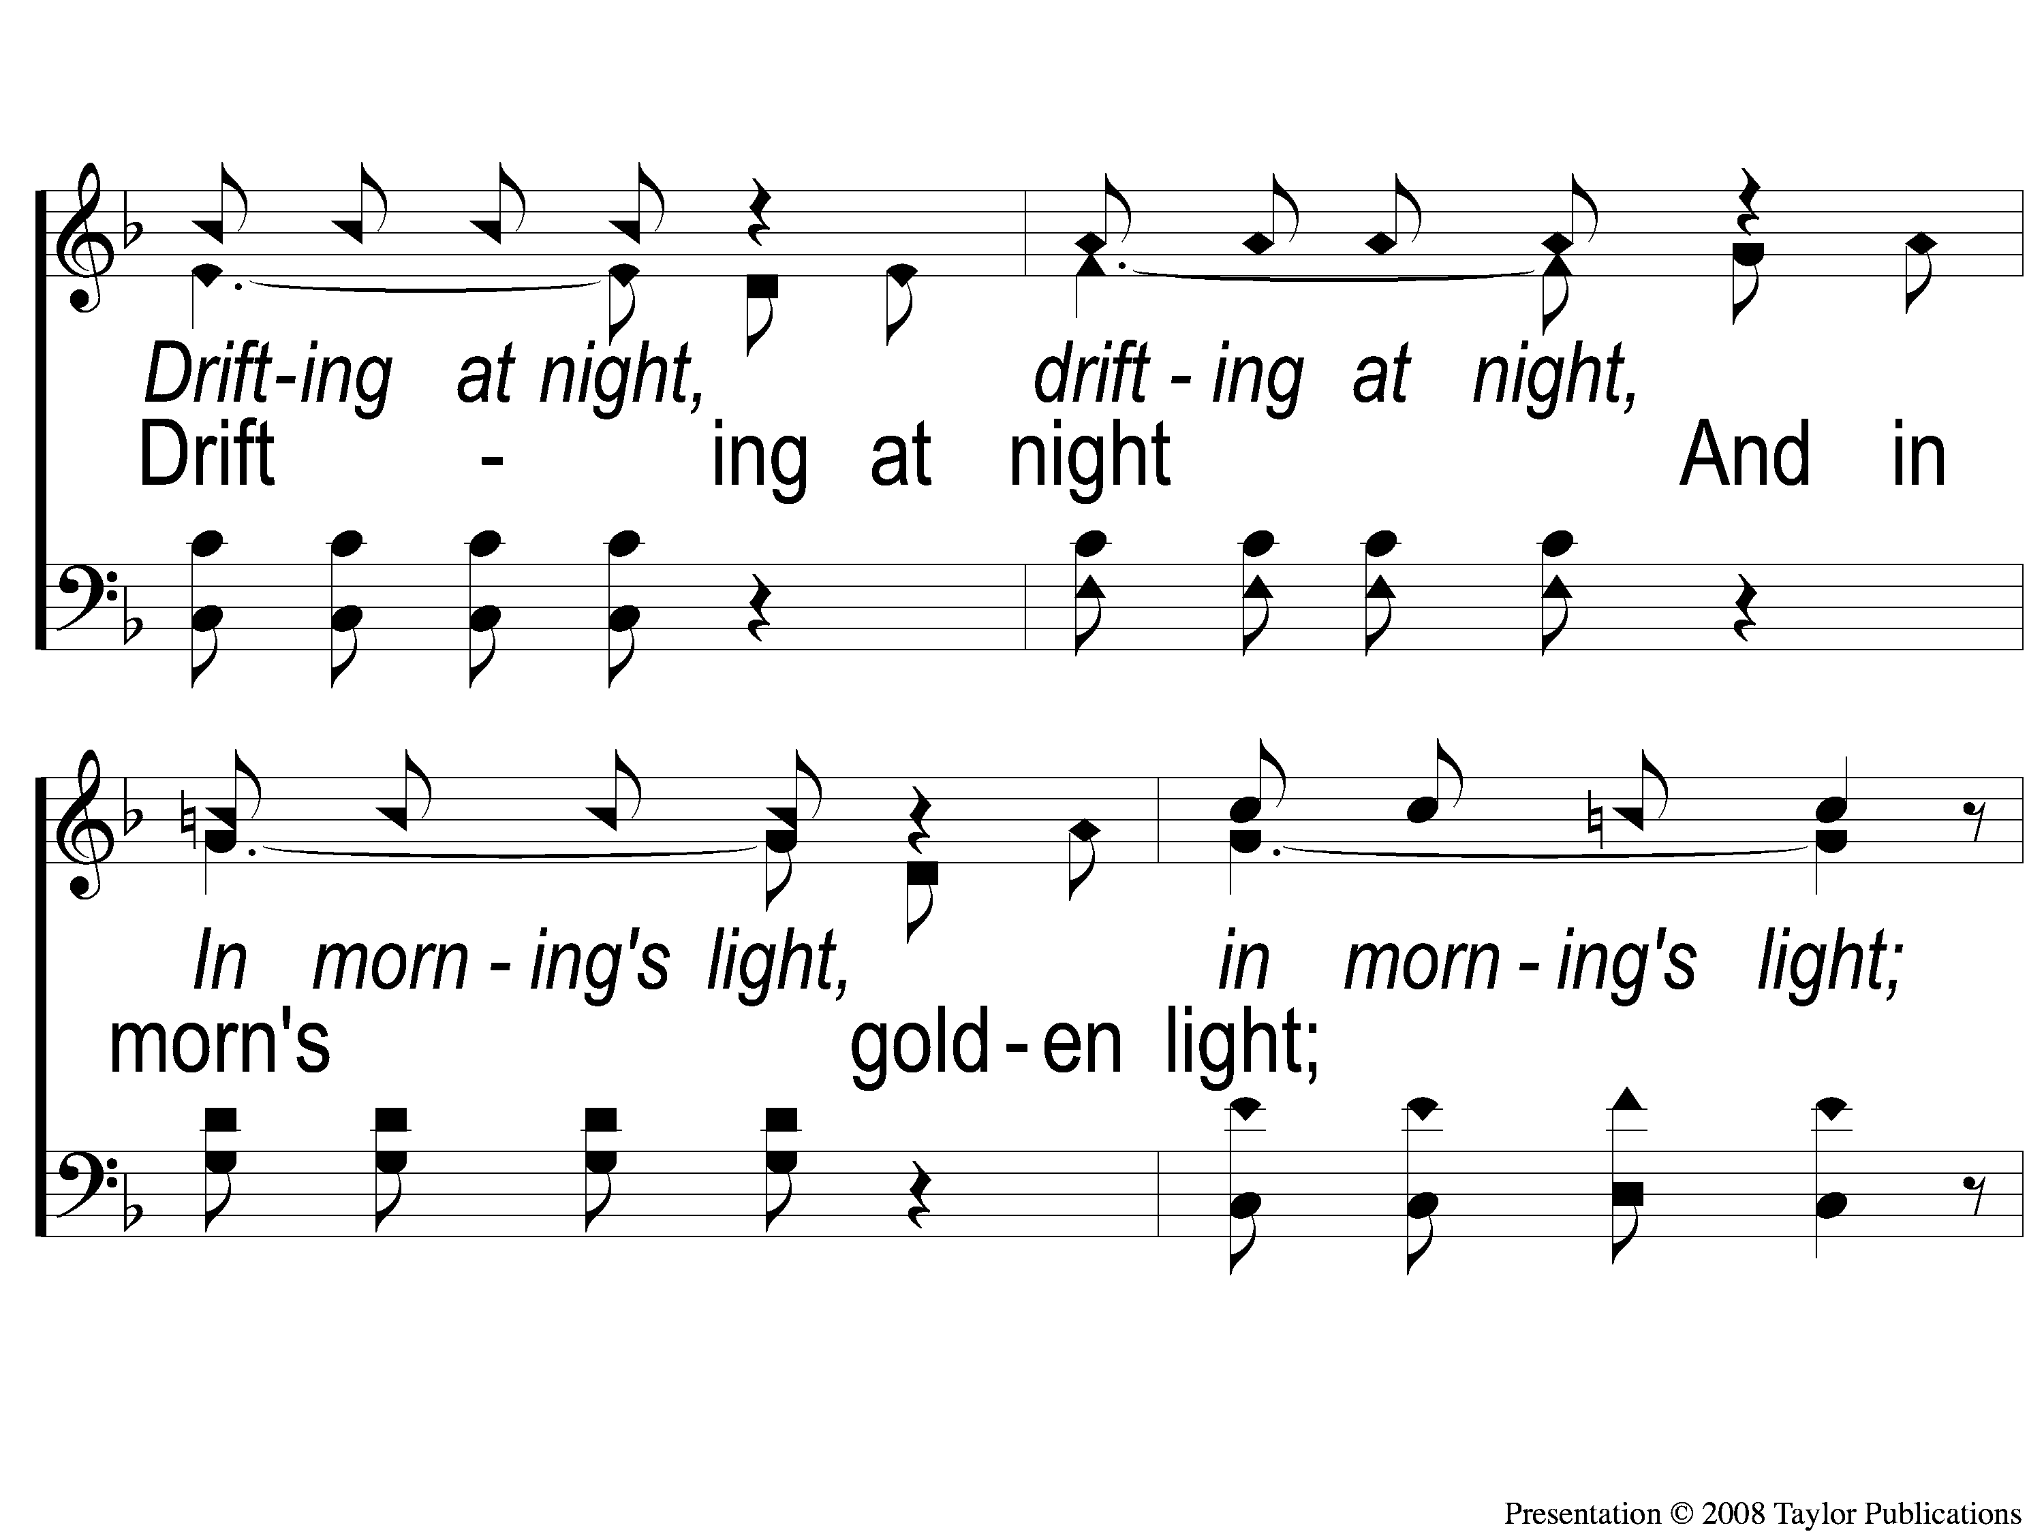
C-2 Drifting Alone
Drifting Along
91

Slide 5
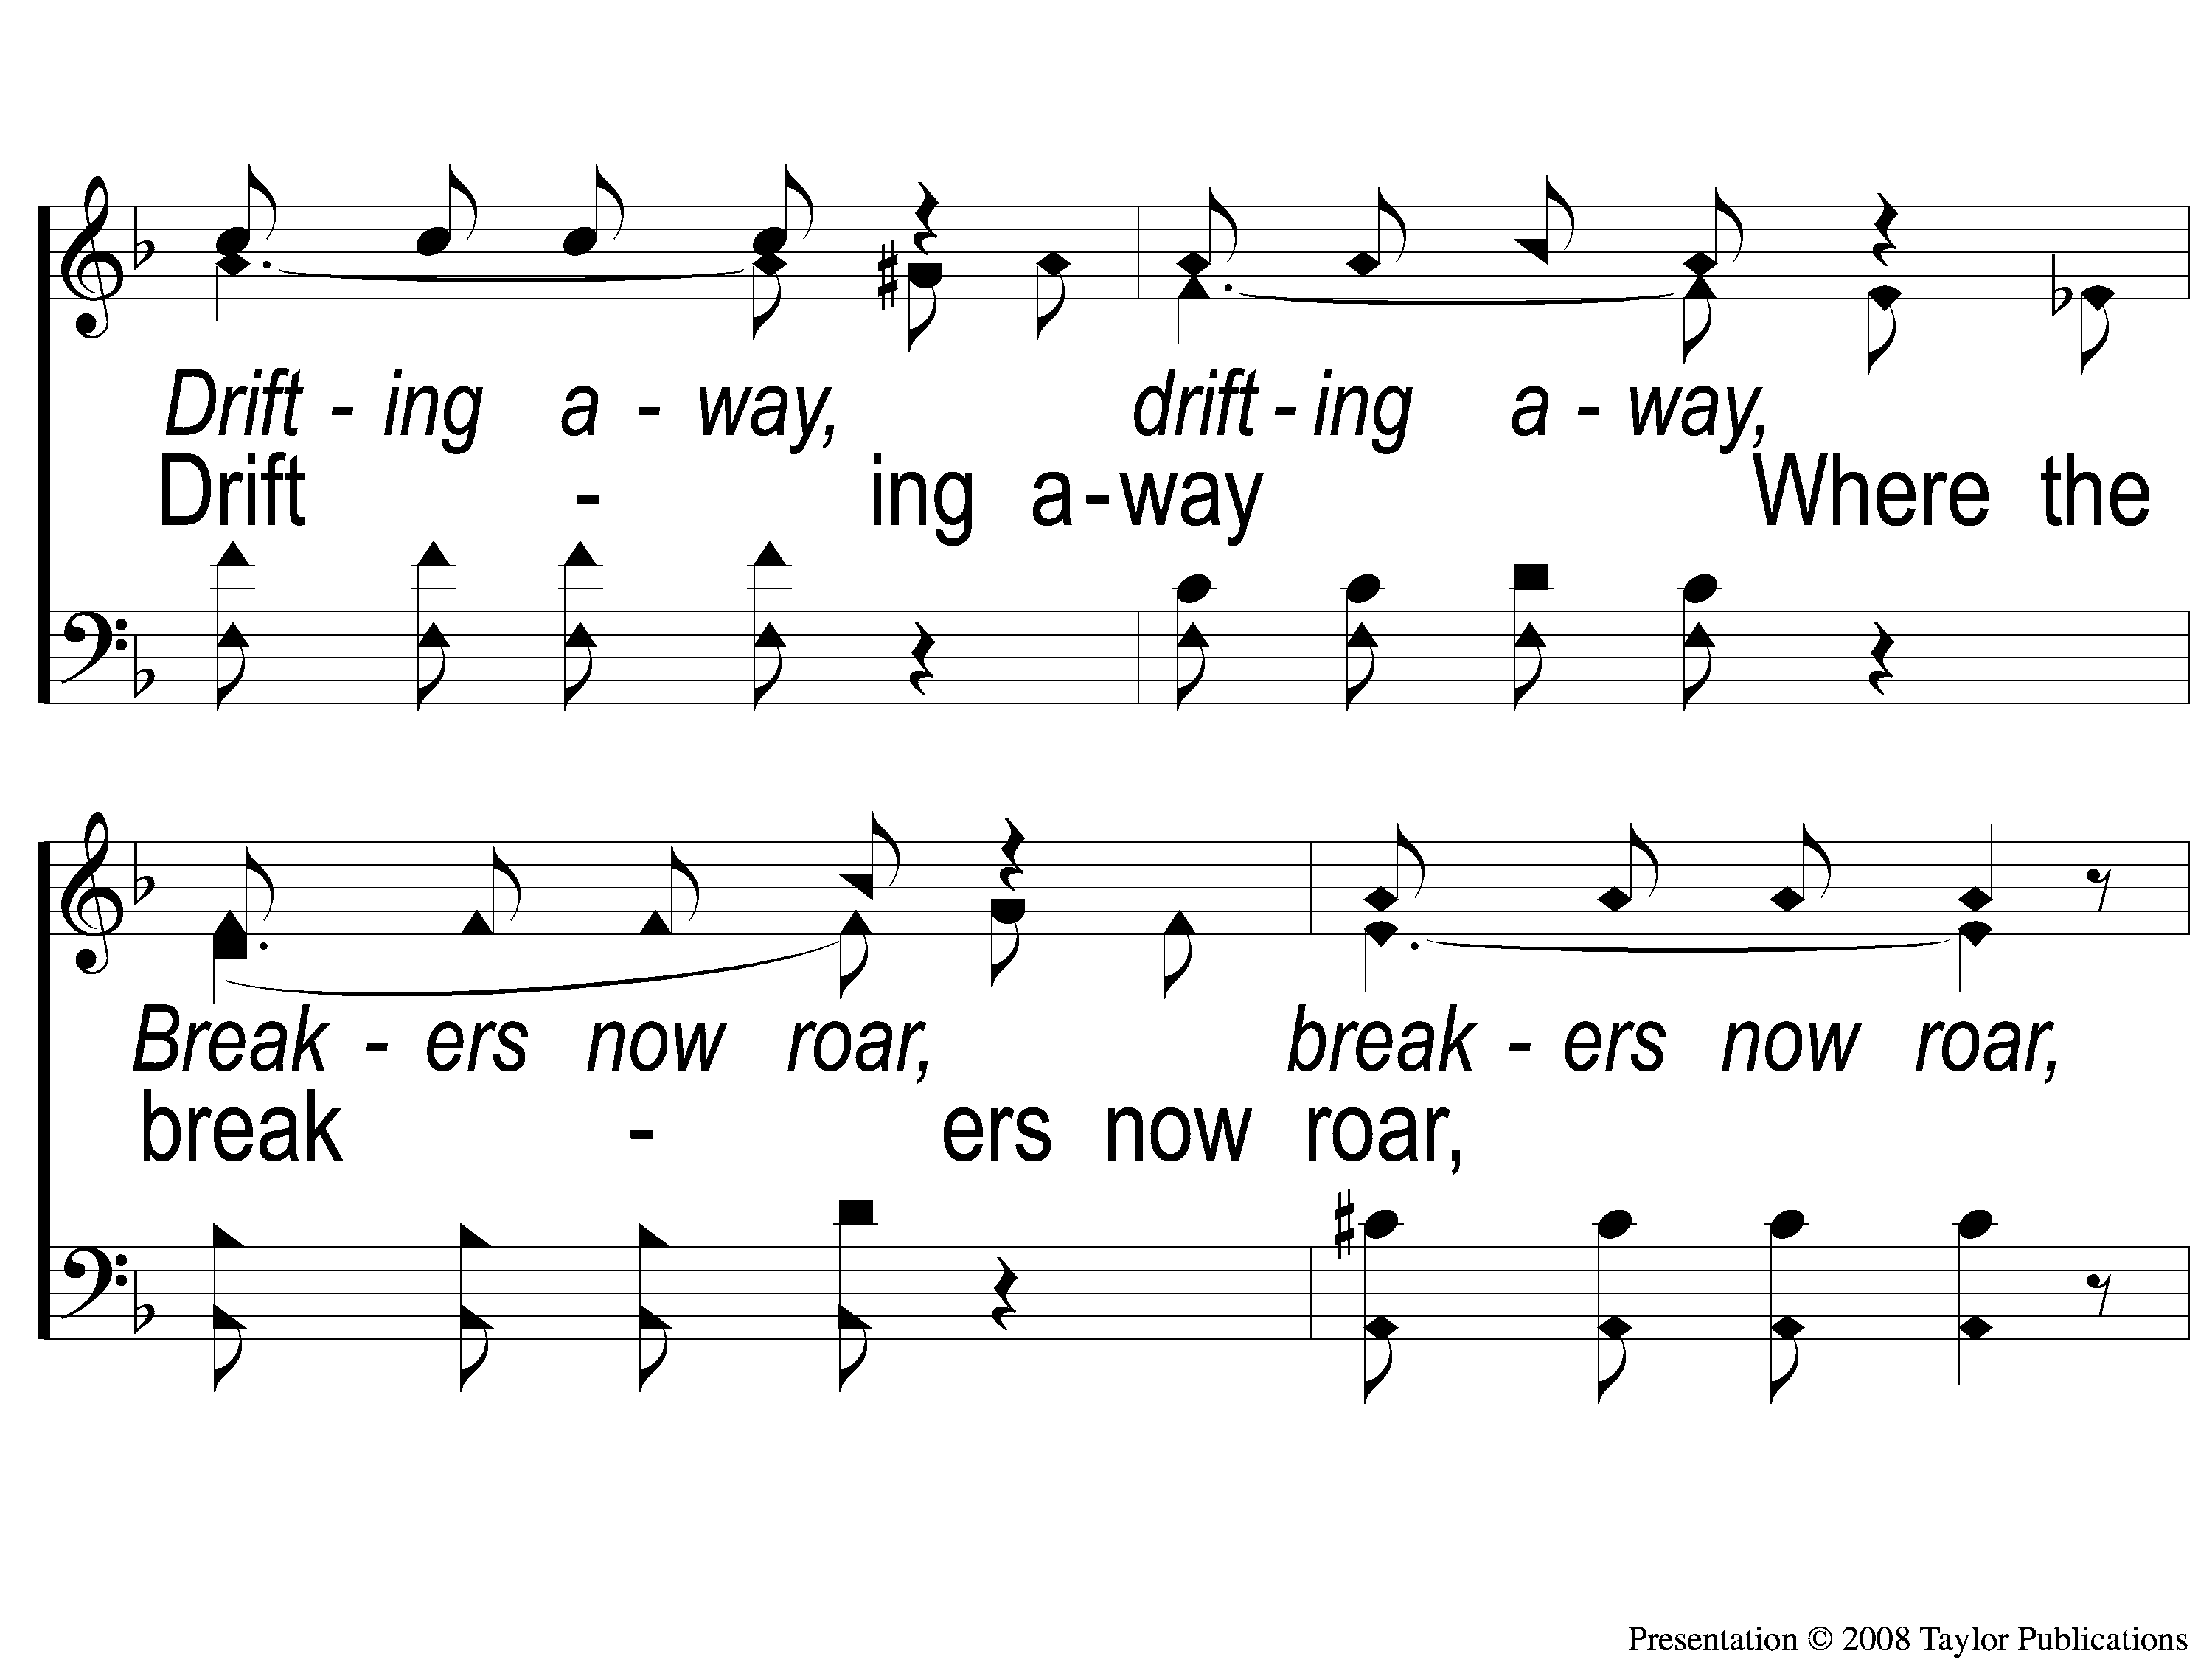
C-3 Drifting Alone
Drifting Along
91

Slide 6
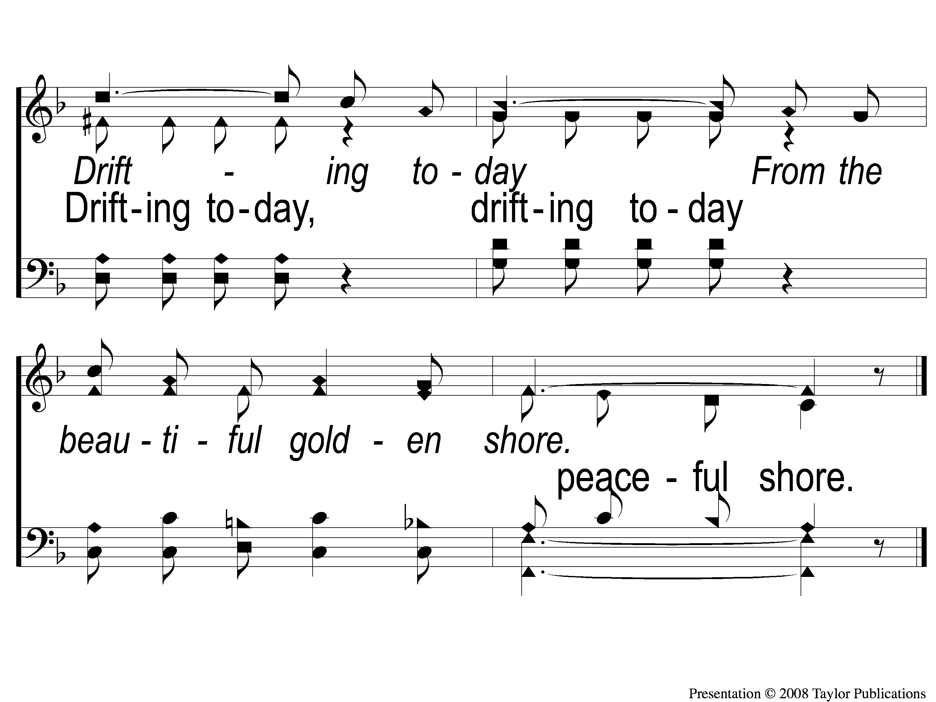
C-4 Drifting Alone
Drifting Along
91

Slide 7
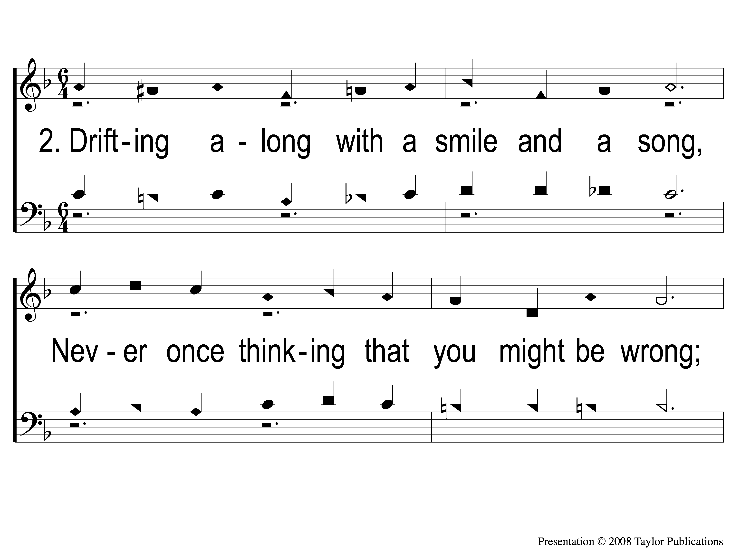
2-1 Drifting Alone
Drifting Along
91

Slide 8
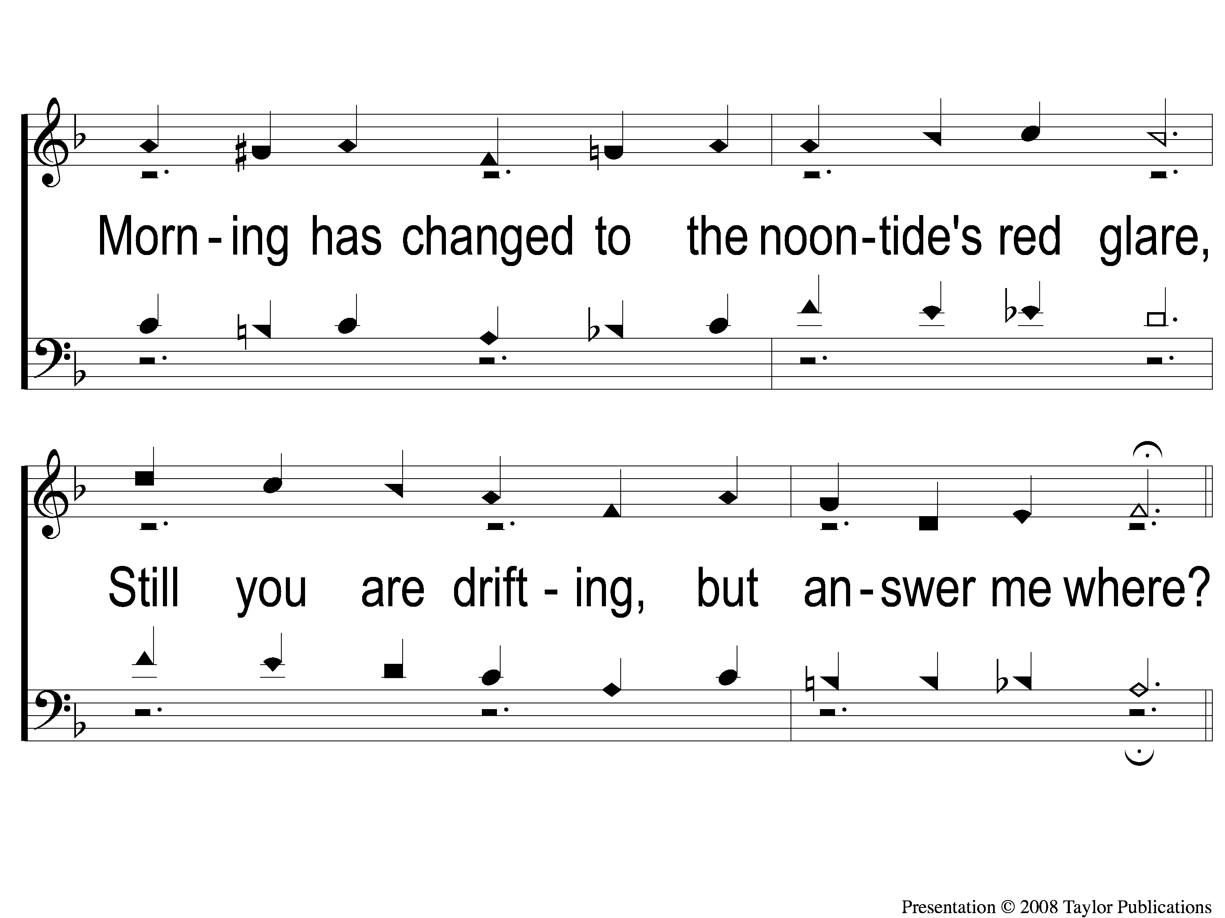
2-2 Drifting Alone
Drifting Along
91

Slide 9
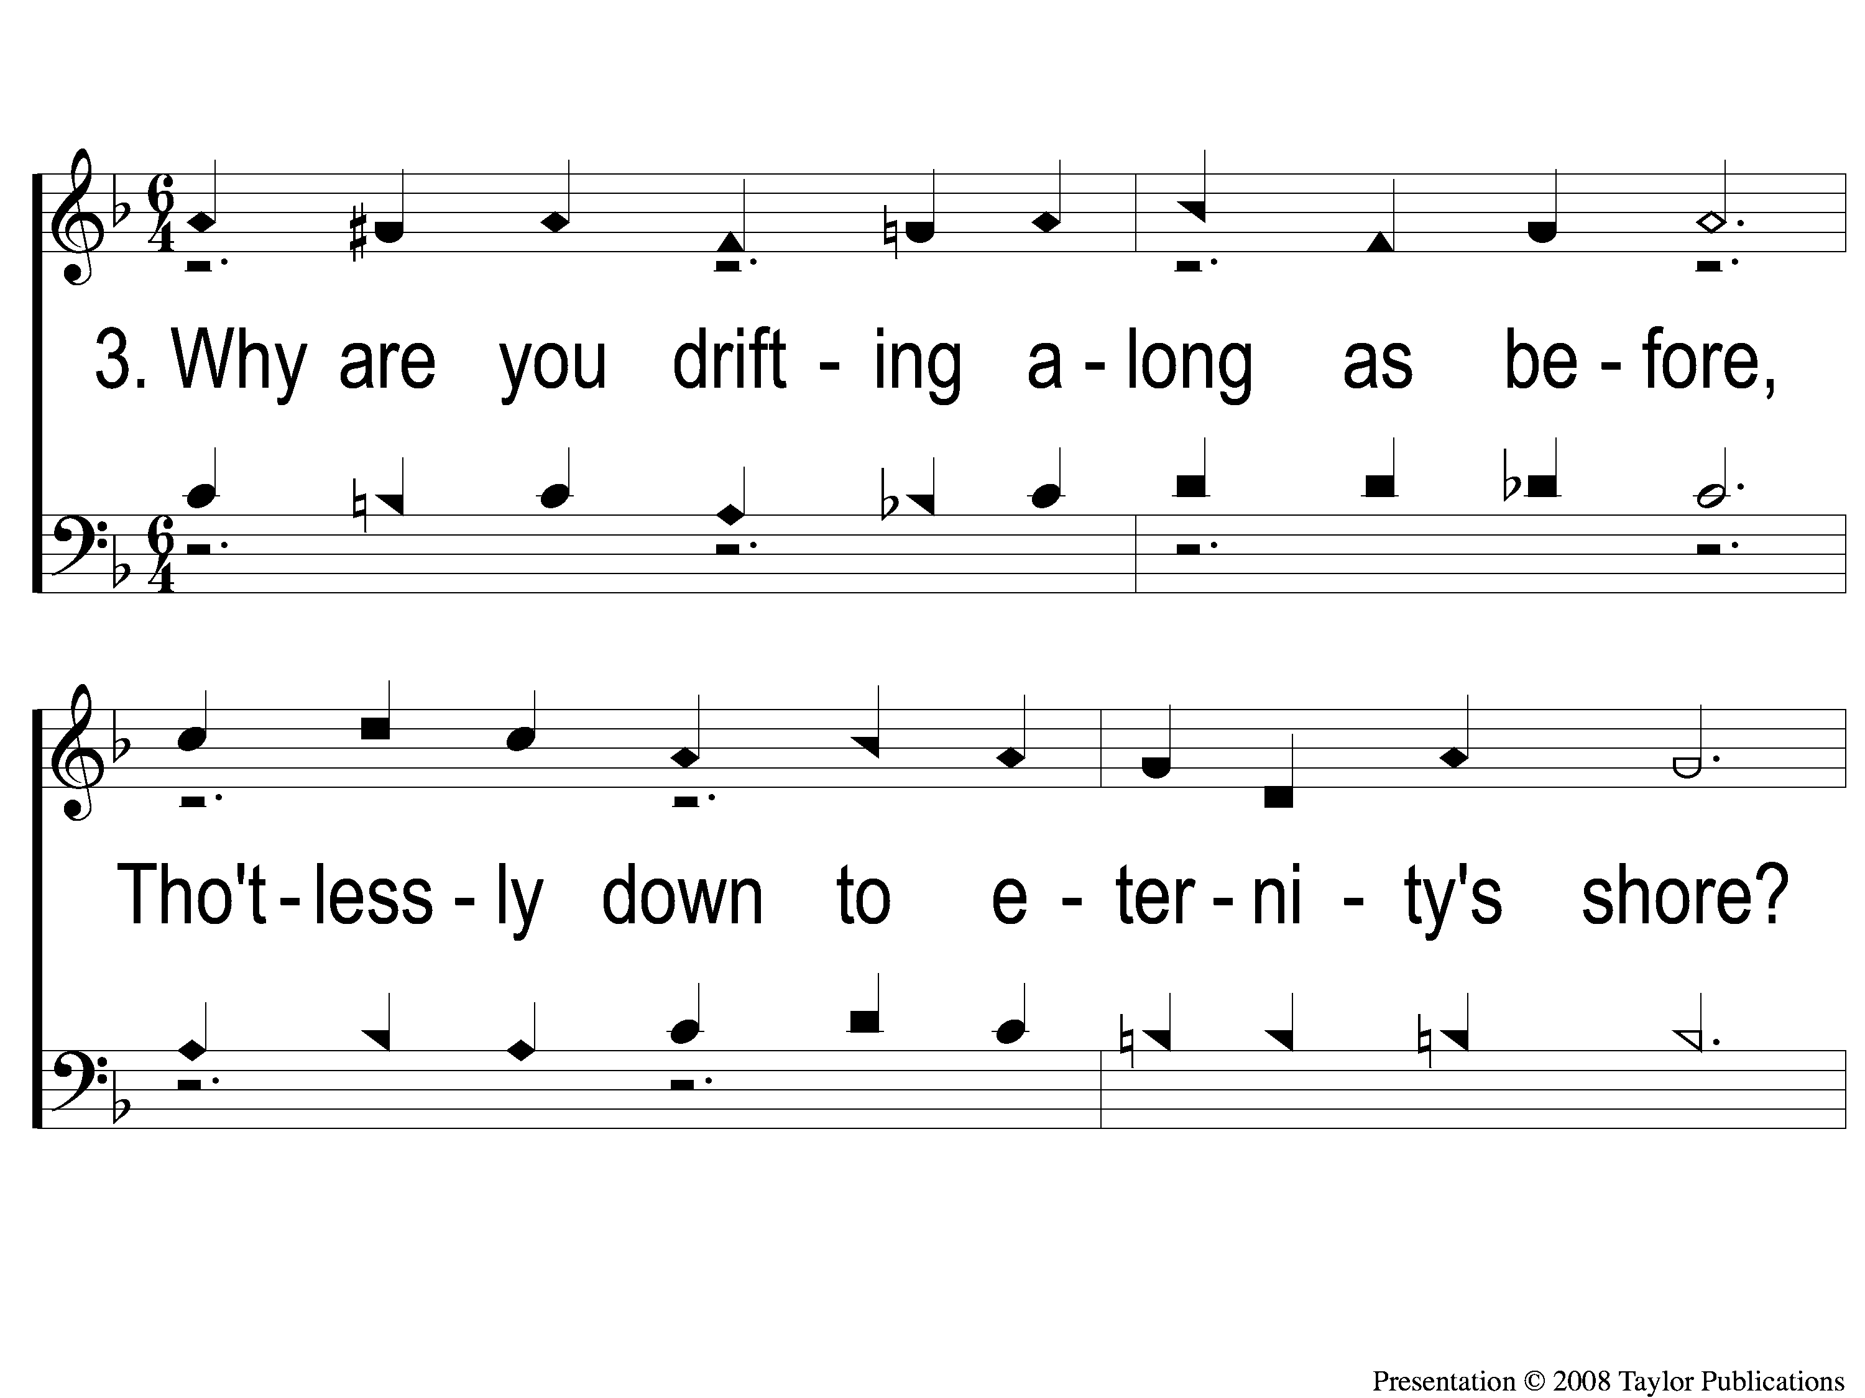
3-1 Drifting Alone
Drifting Along
91

Slide 10
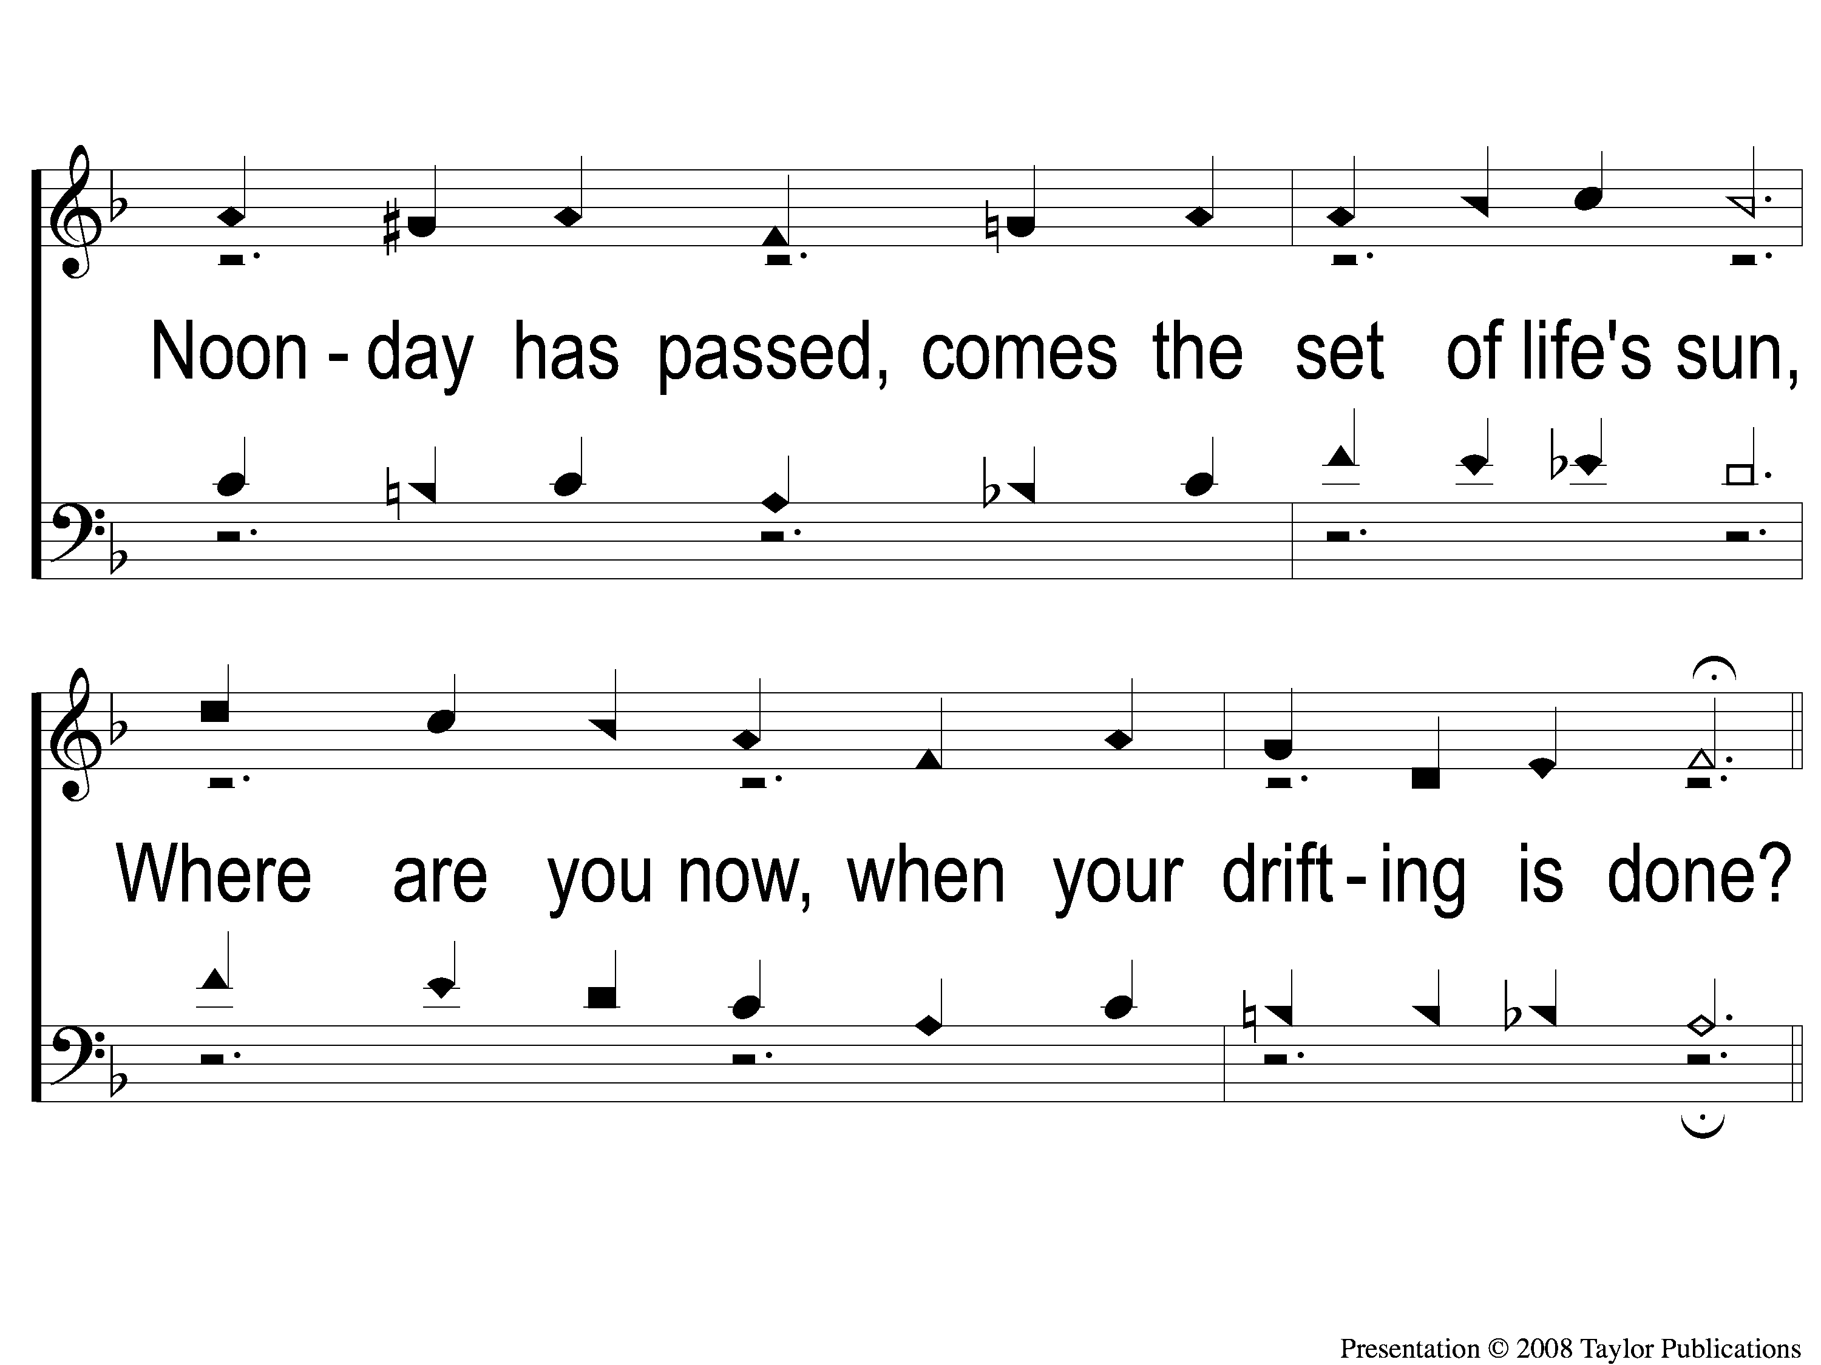
3-2 Drifting Alone
Drifting Along
91

Slide 11
C-1 Drifting Alone
Drifting Along
91

Slide 12
C-2 Drifting Alone
Drifting Along
91

Slide 13
C-3 Drifting Alone
Drifting Along
91

Slide 14
C-4 Drifting Alone
Drifting Along
91

